Slide 1
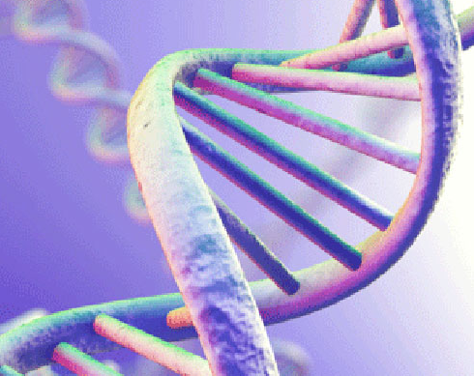
NEXTGEN SEQUENCING-PRECISION MEDICINE
Tran Thi Hien- Sunmil Lab

Slide 2

Introduction
The study of genes and DNA
Genetic variations significantly impact an individual's response to drugs and their susceptibility to diseases
Why do genetics play an important role in healthcare?
Genetic information is at the core of precision medicine
NGS has revolutionized the biological sciences
Read an individual's entire genetic makeup quickly and cost-effectively
Nextgen sequencing
Pharmacogenetics
Explores how genetic differences can influence how people metabolize and respond to medications
Notes:
https://emea.illumina.com/science/technology/next-generation-sequencing.html#:~:text=What%20is%20NGS%3F,regions%20of%20DNA%20or%20RNA.

Slide 3
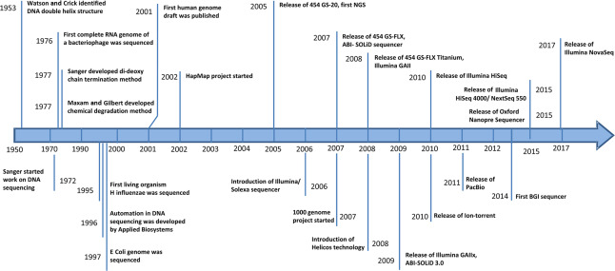
The timeline where different NGS technologies and their platforms

Slide 4
What is NGS?
Define: NGS is a new technology for DNA and RNA sequencing and variant/mutation detection
Advantages
Higher sensitivity to detect low-frequency variants
Faster turnaround time for high sample volumes
Comprehensive genomic coverage
Lower limit of detection
Higher capacity with sample multiplexing
Ability to sequence hundreds to thousands of genes or gene regions simultaneously

Slide 5
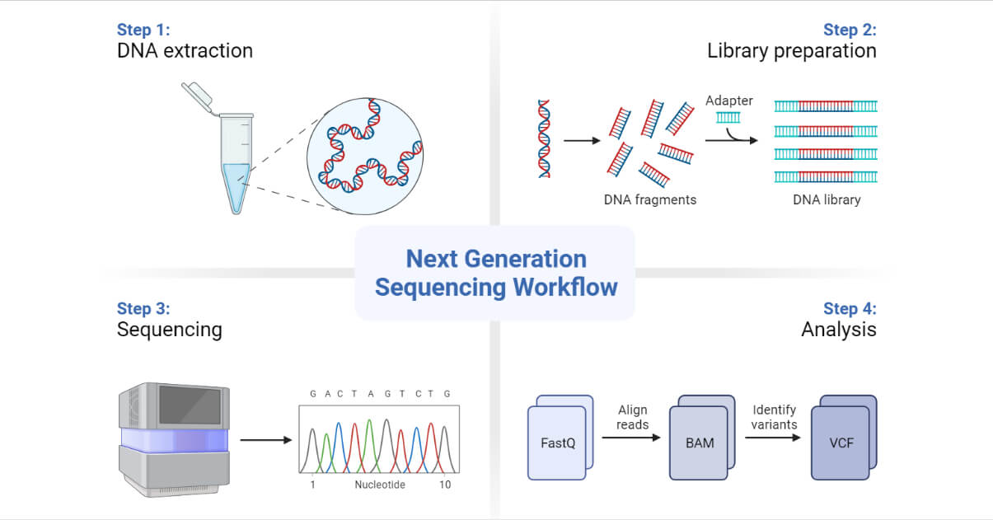
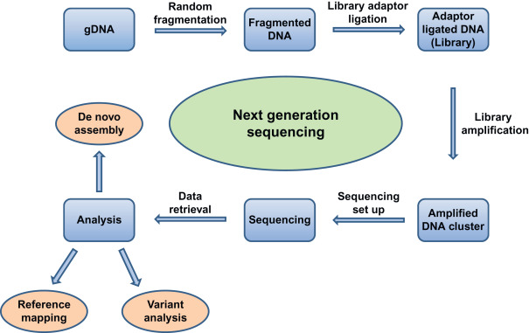
The NGS process
Basic scheme of a NGS experiment.

Slide 6
Analyzing NGS Data
Step 1.
Cleaning of NGS data
Step 2.
Exploration of NGS data
Step 3.
Visualization of NGS data
Step 4.
Deeper analyses of NGS data

Slide 7

Next-generation sequencing to improve diagnosis and surveillance of infectious diseases
https://www.youtube.com/watch?v=SwNXNFBIGKc

Slide 8
Pharmacogenetic Polymorphism
Pharmacogenetic polymorphism as genetic variations that impact how an individual responds to drugs. These variations can include single-nucleotide changes, insertions, deletions, or other genetic alterations.
Impact on Drug Metabolism and Response
Relevance to Precision Medicine

Slide 9
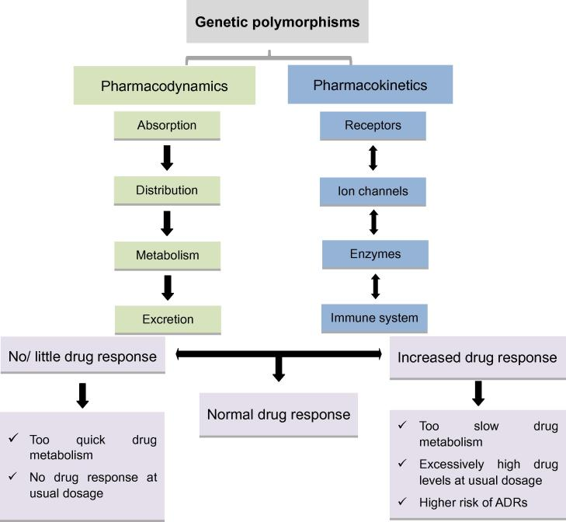
Pharmacogenetic Polymorphism
Impact on Drug Metabolism and Response
Effect of genetic polymorphisms on individuals’ drug response

Slide 10
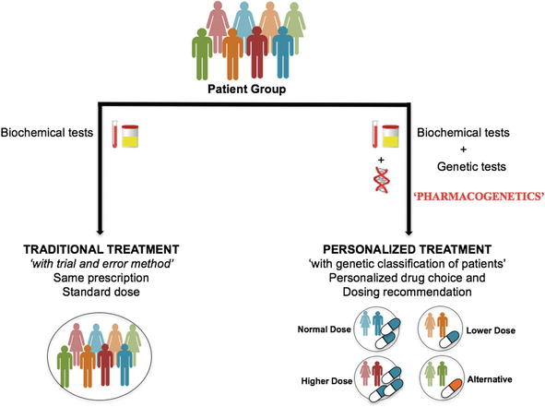
Pharmacogenetic Polymorphism
Relevance to Precision Medicine
Exp: VKORC1

Slide 11
Benefits & Applications
Are you aware of the sectors where we are implementingNext-Generation Sequencing (NGS), Pharmacogenetic Polymorphism?

Slide 12
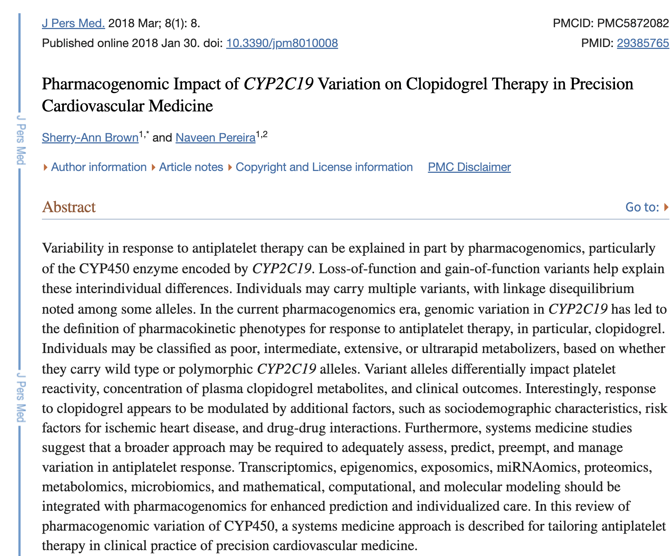

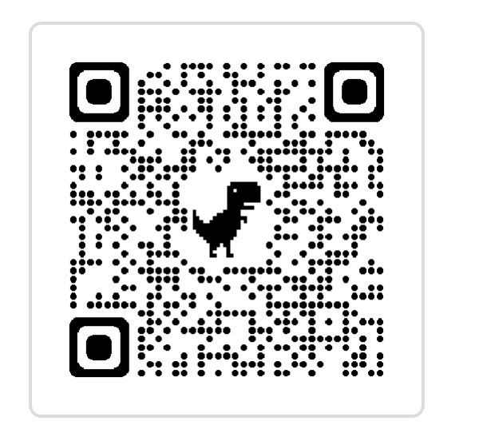
Pharmacogenetic Polymorphism - CYP2C19 Gene and Clopidogrel Response in Heart Disease

Slide 13
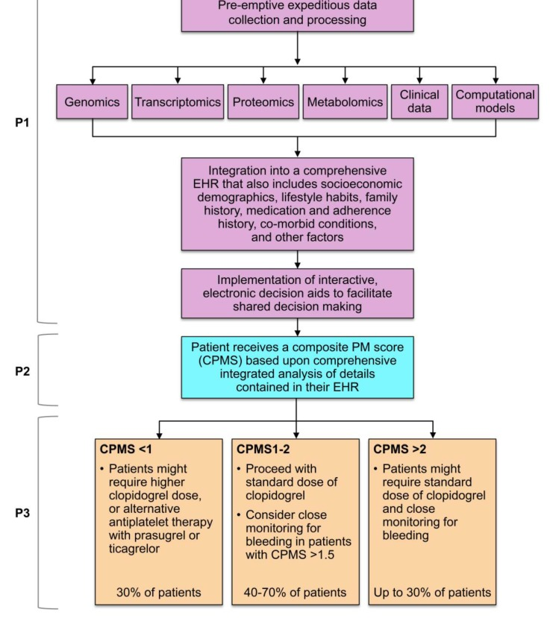
The precision medicine approach to tailoring antiplatelet therapy.

Slide 14
Conclusion
The potent synergy of genetics, Next-Generation Sequencing (NGS), and precision medicine.
OUR unique genetic constitution plays a pivotal role in determining your response to medications.
Precision medicine is characterized by personalization, prediction, prevention, and active patient involvement, utilizing genetics to redefine healthcare.
NGS has brought about a transformative shift in genetic analysis.
In the domain of pharmacogenetic polymorphism, OUR genetic variances take the lead in shaping medication choices and dosages, exemplifying personalized medicine in practice.

Slide 15
THANK YOU FOR LISTENING

Slide 16
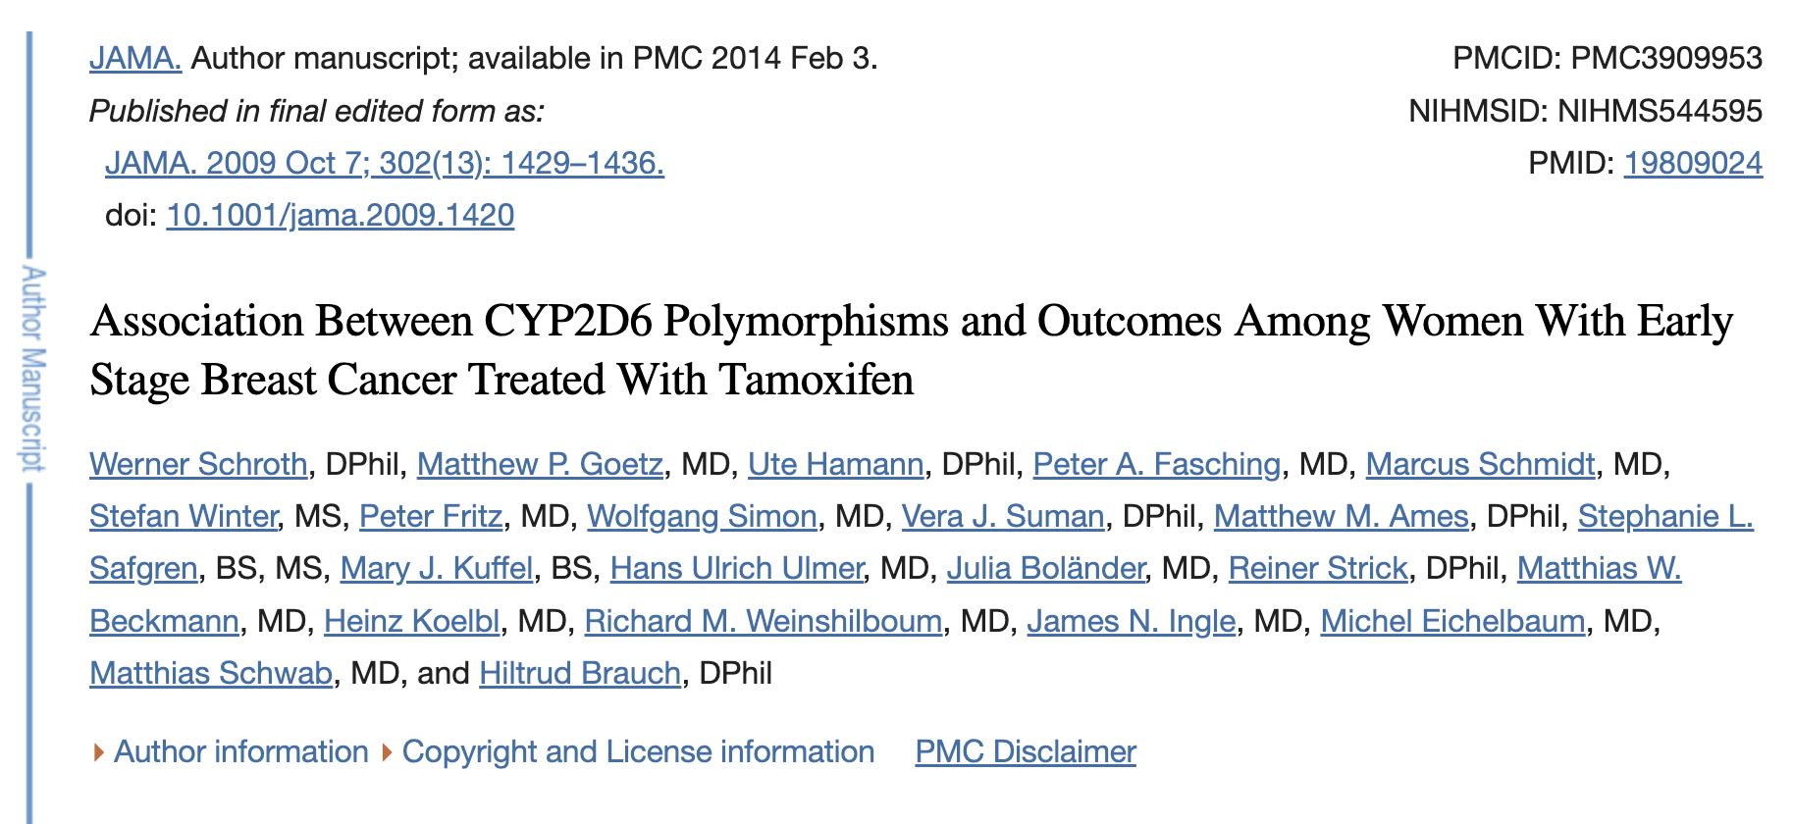
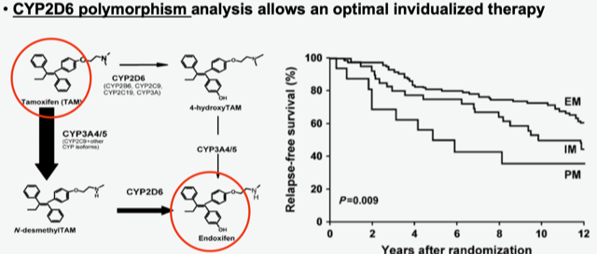
Genetic variations in the CYP2D6 gene affect
how individuals metabolize drugs
Poor Metabolizers (PMs): Individuals with two non-functional CYP2D6 alleles have limited enzyme activity, affecting the effectiveness of codeine and tamoxifen.
Intermediate Metabolizers (IMs): IMs have one non-functional allele and one functional allele, resulting in reduced enzyme activity.
Extensive Metabolizers (EMs): EMs have two fully functional CYP2D6 alleles, leading to standard drug metabolism.
Ultra-Rapid Metabolizers (UMs): UMs possess multiple copies of functional alleles, resulting in exceptionally high enzyme activity
Notes:
as exemple when you talk about pharmacogenetic polymorphisms on page 13 you can cite the well known CYP450 polymorphisms (classification of individuals into low, middle and high metboiizers).
this has been of great clinical use to approriiatly dose the patients (eg tamoxifen for breast cancer and serotonin uptake inhibitors for bipolar symptoms)
eg. a breast cancer patient is not appropriately taken care of if you administer a too lower dose to a high metabolizer individual. CYP2D6 Polymorphism: Explain how genetic variations in the CYP2D6 gene can affect how individuals metabolize drugs, such as codeine and tamoxifen. Mention the classification of individuals into poor metabolizers, extensive metabolizers, etc.
Genetic variations in the CYP2D6 gene significantly influence how individuals metabolize drugs like codeine and tamoxifen.
Understanding a patient's CYP2D6 metabolizer status is crucial in clinical practice for tailoring drug choices and dosages, optimizing treatment outcomes, and minimizing adverse effects, aligning with the principles of precision medicine. a breast cancer patient is not appropriately taken care of if you administer a too lower dose to a high metabolizer individual.
The application of CYP2D6 polymorphism analysis in breast cancer is particularly relevant due to the use of certain medications, especially tamoxifen, in the treatment of this cancer. Tamoxifen is a widely prescribed hormone therapy for estrogen receptor-positive breast cancer, and its metabolism involves the CYP2D6 enzyme. Here's how CYP2D6 polymorphism analysis is applied in the context of breast cancer treatment:
Tamoxifen Metabolism:
Active Metabolite Formation: Tamoxifen undergoes hepatic metabolism, primarily mediated by CYP2D6, to form its active metabolite, endoxifen. Endoxifen is responsible for the therapeutic effects of tamoxifen.
Genetic Variability: Genetic polymorphisms in the CYP2D6 gene can result in different enzymatic activity levels, leading to variability in endoxifen concentrations.
CYP2D6 Phenotypes:
Extensive Metabolizers (EM): Individuals with normal CYP2D6 function are extensive metabolizers, efficiently converting tamoxifen to endoxifen.
Poor Metabolizers (PM): Poor metabolizers have reduced or absent CYP2D6 activity, resulting in lower endoxifen levels. This may impact the effectiveness of tamoxifen.
Intermediate Metabolizers (IM) and Ultrarapid Metabolizers (UM): Intermediate or ultrarapid metabolism can also occur based on specific genetic variants, influencing endoxifen levels.
Clinical Implications:
Efficacy Considerations: CYP2D6 polymorphism analysis helps predict the potential impact of tamoxifen metabolism on treatment efficacy. Poor metabolizers may be at risk of suboptimal response to tamoxifen.
Individualized Therapy: Knowledge of a patient's CYP2D6 phenotype allows healthcare providers to tailor tamoxifen therapy. Adjustments in tamoxifen dosage or considering alternative treatments may be considered for poor metabolizers.
Pharmacogenetic Testing:
Incorporation into Breast Cancer Care: Pharmacogenetic testing, including CYP2D6 analysis, is increasingly incorporated into breast cancer care to guide treatment decisions.
Testing Recommendations: Some guidelines, such as those from the Clinical Pharmacogenetics Implementation Consortium (CPIC), provide recommendations for CYP2D6 genotyping before starting tamoxifen therapy.
Alternative Treatments:
Aromatase Inhibitors: For individuals identified as poor metabolizers or those experiencing suboptimal response to tamoxifen, healthcare providers may consider alternative treatments, such as aromatase inhibitors, which do not rely on CYP2D6 metabolism.
Risk of Recurrence:
Outcome Considerations: Understanding the impact of CYP2D6 polymorphisms is essential for predicting treatment outcomes and may influence decisions regarding adjuvant therapy to reduce the risk of breast cancer recurrence.
Clinical Trials and Research:
Incorporating Genetic Data: Clinical trials and research studies in breast cancer increasingly consider genetic data, including CYP2D6 polymorphism status, to account for inter-individual variability in treatment response.
In summary, CYP2D6 polymorphism analysis has significant implications for optimizing tamoxifen therapy in breast cancer patients. By tailoring treatment based on individual genetic variations, healthcare providers can enhance the efficacy of hormonal therapy while minimizing the risk of adverse effects. This application aligns with the broader goals of personalized medicine in oncology.

Slide 17
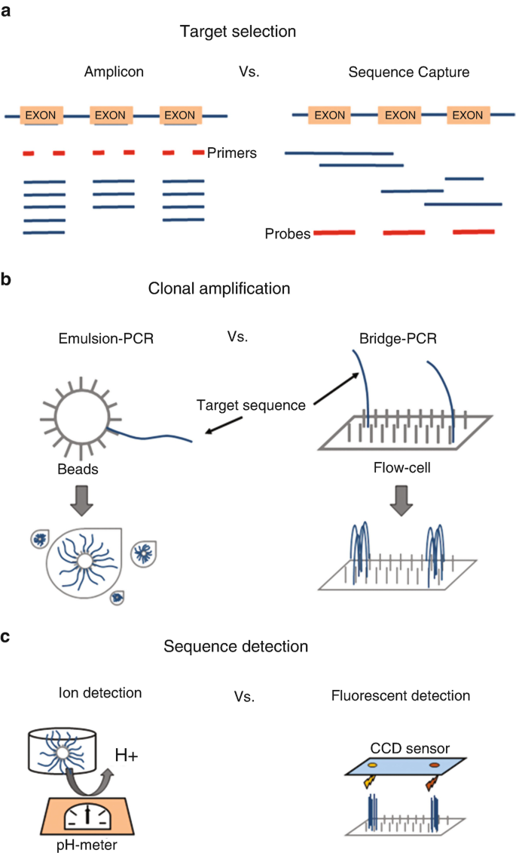
The NGS process (example-Breast Cancer)
Notes:
Summary of main NGS techniques. Regardless of the methods used in each platform, NGS generally involves three steps—library preparation, nucleic acid sequencing, and data analysis. (a) In the amplicon method, specific primers are used to define the region of interest for target selection, while in the sequence capture method, insert size is defined by mechanical or enzymatic fragmentation and selected by specific probes. (b) Clonal amplification generates approximately 1000 copies of the target fragment, through emulsion PCR or bridge PCR, from a single molecule fixed on beads or flow-cell, respectively, to amplify the signal to be detected by the sequencers. (c) The detection in Illumina sequencing occurs through a fluorescent light sensor according to incorporated nucleotide (reversible terminator chemistry), whereas detection in ion sequencing occurs by an ion sensor, which captures the release of the H⁺ ion during the nucleotide incorporation
https://link.springer.com/chapter/10.1007/978-981-19-0197-3_20
Sample Collection and Preparation:
Tumor Biopsy: Obtain a tissue sample from the breast tumor. This could be collected through a biopsy or surgery.
Normal Tissue Sample: Collect a matched normal tissue sample (usually from the blood) to distinguish between somatic and germline mutations.
DNA Extraction and Quality Control:
DNA Extraction: Extract high-quality genomic DNA from both the tumor and normal tissue samples.
QC (Quality Control): Assess the quality and quantity of the extracted DNA to ensure suitability for sequencing.
Library Preparation:
Fragmentation: Fragment the genomic DNA into smaller, manageable pieces.
Adaptor Ligation: Ligase adaptors to the DNA fragments. These adaptors contain sequences that allow the DNA fragments to bind to the sequencing platform.
Amplification: Amplify the library to create sufficient quantities of DNA for sequencing.
Sequencing:
Cluster Generation: Immobilize the DNA fragments on a flow cell and amplify them to create clusters of identical sequences.
Sequencing Chemistry: Employ NGS technology (e.g., Illumina sequencing) to determine the sequence of each DNA fragment within the clusters.
Data Analysis:
Base Calling: Convert raw sequencing signals into nucleotide sequences.
Alignment: Map the sequenced reads to a reference genome.
Variant Calling: Identify genetic variants, including single nucleotide polymorphisms (SNPs), insertions, deletions, and structural variations.
Annotation: Annotate identified variants to understand their potential functional and clinical significance.
Interpretation:
Biological Interpretation: Analyze the identified genetic variants in the context of known breast cancer-associated genes and pathways.
Clinical Interpretation: Evaluate the clinical significance of the identified variants, considering their potential impact on prognosis, treatment response, and risk assessment.
Reporting:
Generate Reports: Summarize the results, including identified genetic alterations and their potential clinical implications.
Integration with Clinical Data: Integrate NGS findings with other clinical and pathological information to guide treatment decisions.
Follow-up and Validation:
Validation: Confirm key findings using orthogonal methods such as Sanger sequencing or targeted PCR.
Clinical Follow-up: Monitor patient response to treatment based on the genetic information obtained from NGS.
It's important to note that the specific details of the NGS process for breast cancer may vary depending on the research or clinical goals, the type of NGS platform used, and the depth of sequencing required. Additionally, the analysis may include specific panels focused on breast cancer-related genes or may involve whole-genome or whole-exome sequencing for a comprehensive genomic profile.
Regenerate

